Slide 1
Introduction To Operating
1
System and It’s Types
:

Slide 2
Agenda
2
▶ Introduction to Operating System
▶ Types of Operating Systems
▶ Operating System – Services
▶ Operating System - I/O Software's
▶ Operating System - File System
▶ Different Flavors of Operating System

Slide 3
Introduction To Operating System
3
▶ Unprecedented(لاثم ےب) growth of computing during the past several
decades.
▶ Desktop workstations execute billions of instructions per second (BIPS)
▶ Supercomputers can execute over a trillion instructions per second
▶ Computers are now employed in almost every aspect of life.

Slide 4
What Is an Operating System?
4
▶ Some years ago an operating system was defined as the software that controls the hardware.
▶ Landscape (نیئزت یک نیمز) of computer systems has evolved significantly,
requiring a more complicated definition.
▶ Applications are now designed to execute concurrently.

Slide 5
What Is an Operating System?
5
▶ Separates applications from the hardware they access
▶ Software layer
▶ Manages software and hardware to produce desired results
▶ Operating systems primarily are resource managers
▶ Hardware
▶ Processors
▶ Memory
▶ Input/output devices
▶ Communication devices
▶ Software applications

Slide 6
Types Of Operating System
6
▶ Operating systems are there from the very first computer generation and
they keep evolving with time. In this chapter, we will discuss some of the
important types of operating systems which are most commonly used.
▶ Batch operating system
▶ Time-sharing operating systems
▶ Distributed operating System
▶ Network operating System
▶ Real Time operating System

Slide 7
Operating System - Services
7
▶ An Operating System provides services to both the users and to the
programs.
▶ It provides programs an environment to execute.
▶ It provides users the services to execute the programs in a convenient manner.

Slide 8
Continued
8
▶ Following are a few common services provided by an operating system
▶ Program execution
▶ I/O operations
▶ File System manipulation
▶ Communication
▶ Error Detection
▶ Resource Allocation
▶ Protection

Slide 9
Operating System - I/O Softwares
9
▶ I/O software is often organized in the following layers −
▶
User Level Libraries − This provides simple interface to the user program to perform
input and output. For example, stdio is a library provided by C and C++ programming languages.
▶ Kernel Level Modules − This provides device driver to interact with the device controller and device independent I/O modules used by the device drivers.
▶ Hardware − This layer includes actual hardware and hardware controller which interact with the device drivers and makes hardware alive.
▶ A key concept in the design of I/O software is that it should be device independent where it should be possible to write programs that can access any I/O device without having to specify the device in advance. For example, a program that reads a file as input should be able to read a file on a floppy disk, on a hard disk, or on a CD-ROM, without having to modify the program for each different device.

Slide 10
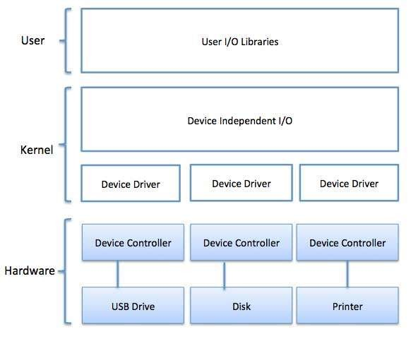
10

Slide 11
Operating System - File System
11
▶ File
▶ A file is a named collection of related information that is recorded on secondary storage such as magnetic disks, magnetic tapes and optical disks. In general, a file is a sequence of bits, bytes, lines or records whose meaning is defined by the files creator and user.

Slide 12
File Structure
12
A File Structure should be according to a required format that the operating
system can understand.
▶ A file has a certain defined structure according to its type.
▶ A text file is a sequence of characters organized into lines.
▶ A source file is a sequence of procedures and functions.
▶ An object file is a sequence of bytes organized into blocks that are understandable by the machine.
▶ When operating system defines different file structures, it also contains the code to support these file structure. Unix, MS-DOS support minimum number of file structure.

Slide 13
Diagram of Operating System
13

Slide 14
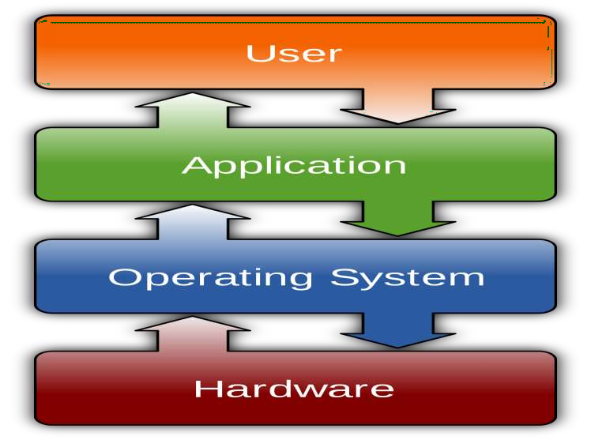
14

Slide 15
Different Operating System
15
▶ Microsoft Windows
▶ Linux OS
▶ Mac OS
▶ Unix OS

Slide 16
16
Introduction to Windows

Slide 17
Agenda
17
▶ Introduction to Windows
▶ Evolution of Windows
▶ Installing of Windows

Slide 18
Introduction To Windows
18
▶Microsoft introduced an operating environment named Windows on November 20, 1985.

Slide 19
Evolution of Windows
19
▶ Windows 3.1
▶ First widely used successful version of Windows
▶ Replaced MS-DOS
▶ Windows 95
▶ Introduced Start button, taskbar for multitasking, and My Computer for easier
file management
▶ Windows NT
▶ Intended for business computing
▶ Increased reliability and security

Slide 20
Evolution of Windows (Continued)
20
▶ Windows 98
▶ Active desktop displays Web content
▶ Enables Web conventions on the desktop
▶ Windows 2000
▶ Security of NT with Windows 98 Interface
▶ Windows 2000 Professional and Windows 2000 Server
▶ Windows Me (Millennium Edition)
▶ Successor to Windows 98 for home computing

Slide 21
Evolution of Windows (Continued)
21
▶ Windows XP
The next major version of Windows NT, Windows XP, was released on October 25, 2001. The introduction of Windows XP aimed to unify the consumer-oriented Windows 9x series with the architecture introduced by Windows NT, a change which Microsoft promised would provide better performance over its DOS-based predecessors.

Slide 22
Evolution of Windows (Continued)
22
▶ Windows Vista: After a lengthy development process, Windows Vista was released on November 30, 2006.
▶ Windows 7: On July 22, 2009, Windows 7 and Windows Server 2008 R2 were released as RTM (release to manufacturing) while the former was released to the public 3 months later on October 22, 2009.

Slide 23
Evolution of Windows (Continued)
23
▶ Windows 8 and 8.1
Windows 8, the successor to Windows 7, was released generally on October 26, 2012. A number of significant changes were made on Windows 8, including the introduction of a user interface based around Microsoft's Metro design language with optimizations for touch-based devices such as tablets and all-in-one PCs. These changes include the Start screen, which uses large tiles that are more convenient for touch interactions and allow for the display of continually updated information, and a new class of apps which are designed primarily for use on touch- based devices.

Slide 24
Evolution of Windows (Continued)
24
▶ Windows 10
On September 30, 2014, Microsoft announced Windows 10 as the successor to Windows 8.1. It was released on July 29, 2015, and addresses shortcomings in the user interface first introduced with Windows 8.
Changes include the return of the Start Menu, a virtual desktop system, and the ability to run Windows Store apps within windows on the desktop rather than in full-screen mode

Slide 25
Installation of Windows 8/8.1
25

Slide 26
System Requirements
26
▶ Processor 1 GHz (32-bit or 64-bit processor)
▶ RAM 1GB (32bit) or 2GB (64bit)
▶ HDD 16GB (32bit) or 20GB (64bit)
▶ DVD- Drive
▶ Internet access (to activate and get updates)

Slide 27
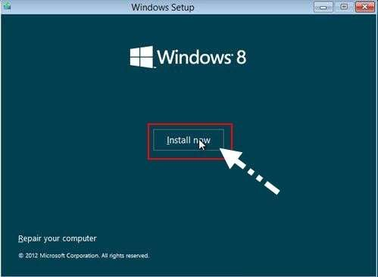
Windows 8 Installation
27

Slide 28
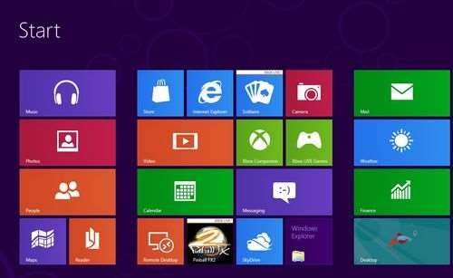
Windows 8 Installation
28

Slide 29
THE END
29

